Slide 1
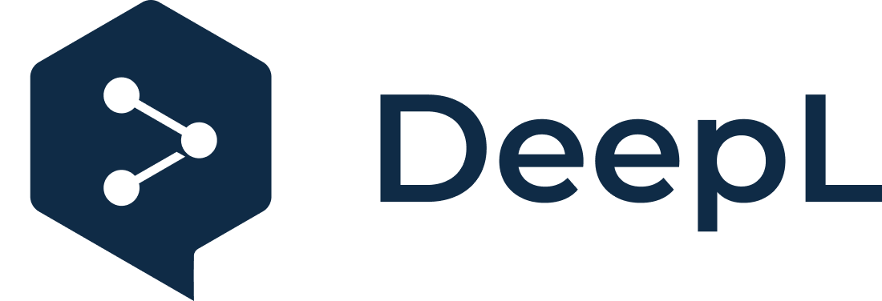
Subscribe to DeepL Pro to edit this document.
Visit www.DeepL.com/pro for more information.

Slide 2
Multiplatform Programming
Intelligent Infrastructure Design for the Internet of Things
Antonio Navarro

Slide 3
Index
References
Introduction
What is a platform?
A model-based approach
Cross-platform development tools
Apache Cordova
Conclusions

Slide 4
References
(Abernethy, 2011) Abernethy, M. Just what is Node.js? https://www.ibm.com/developerworks/ssa/opensource/library/os-nodejs/index.html
(Baldwin, 2017) Baldwin, Ch. Cross Platform Mobile Development Tools: Ending the iOS vs. Android Debate. http://thinkapps.com/blog/development/develop-for-ios-v-android-cross-platform-tools/
(Clutch, 2017) Top Cross Platform App Development Tools. https://clutch.co/app-development/cross-platform
(Cortes&Navarro, 2017) Cortes, H., Navarro, A. Enterprise WAE: a lightweight UML extension for the characterization of the presentation tier of enterprise applications with MDD-based mockup generation. IJSEKE, 27(8)

Slide 5
References
(Furlan, 2017) Furlan, A. Cross Platform Mobile App Development Guide 2017. http://www.businessofapps.com/guide/cross-platform-mobile-app-development/
(Looper, 2015) Looper, J. What is a WebView? https://developer.telerik.com/featured/what-is-a-webview/
(OMG, 2003) MDA Guide version 1.0.1 http://www.omg.org/news/meetings/workshops/UML_2003_Manual/00-2_MDA_Guide_v1.0.1.pdf
(Wiki, 2018) Wikipedia. Computing Platform. https://en.wikipedia.org/wiki/Computing_platform

Slide 6
Introduction
In this topic we will analyze the concept of platform and we will see some examples of development in Apache Cordova.
The objectives of the topic are:
Familiarization with the platform concept
To know the basic concepts of model-driven architecture.
See how Apache Cordova is able to do cross-platform development.
The practice of this topic will provide an Apache Cordova code to be modified.

Slide 7
What is a platform?
The first definition of platform that comes to mind is the one provided by the MDA-Guide (OMG, 2003): A platform is a set of subsystems and technologies that provide a coherent set of functionality through defined interfaces and patterns of use, which any application supported by the platform can use without concern for the details of how the functionality provided by the platform is implemented

Slide 8
What is a platform?
The guide itself gives examples of platform types:
Generic
Object-oriented
By batches
Data flows
Technology specific:
CORBA
J2EE
Vendor specific
CORBA: Micro Focus Orbix
J2EE: IBM WepSphere, Oracle WebLogic
Microsoft .NET

Slide 9
What is a platform?
This concept is a bit lofty, and we will return to it later.
Perhaps the Wikipedia concept is closer to what is currently handled (Wiki, 2018): A computing platform is the environment in which a piece of software runs. It can be the hardware, or the operating system, or even a web browser or other underlying software, as long as the program code runs on it. A platform has different levels of abstraction: (i) computer architecture; (ii) operating system; (iii) execution libraries.

Slide 10
What is a platform?
With such a generic definition, Wikipedia considers almost anything a platform:
Hardware, as in the case of embedded systems
Browser
a scripting language application (such as a spreadsheet)
Software frameworks, such as J2EE
Cloud computing and Platform as a Service environments
Virtual machines, such as Java
Virtualized versions of complete systems

Slide 11
What is a platform?
In fact, Wikipedia itself considers that a platform can be a combination of hardware, operating system and software framework.
So, what should we understand by platform?
Whatever interests us in the context:
For example, in web development we can talk about J2EE or .NET.
In mobile development, we can talk about Android, iOS or Windows Phone.

Slide 12
A model-based approach
We will dedicate a couple of slides to the Model-Driven Architecture (MDA) approach of the Object-Management Group (OMG, 2003).
One of the main objectives of MDA is to make the specification of a system independent of the implementation details.
MDA provides a framework that allows:
Give a specification of a system independent of implementation details.
Specify implementation platforms
Choose one of these platforms
Transform the system specification into an implementation platform.

Slide 13
A model-based approach
Independence is achieved using different types of models
These models allow to provide different system specifications from different points of view
These models are:
CIM (Computation Independent Model): system characterization from the domain point of view (domain/business model)
PIM (Platform Independent Model): design view omitting platform-specific details
PSM (Platform Specific Model): design view considering specific details of a platform.

Slide 14
A model-based approach
A fundamental component of the MDA approach is the use of transformations, especially in the transition from PIM to PSM.
To define transformations between models, transformation rules are defined between models of models, i.e. between metamodels.
For example, we have E-WAE (Cortés&Navarro, 2017).
PIM: E-WAE, notation for characterizing presentation layer enterprise applications
PSMs: WAE4JSF, WAE4.NET: notations for characterizing presentation layer JSF and ASP .NET MVC enterprise applications
Transformations: PIM -> PSMs -> code

Slide 15
A model-based approach
Example authentication and address on Amazon:
Authentication and shipping address selection in Amazon

Slide 16
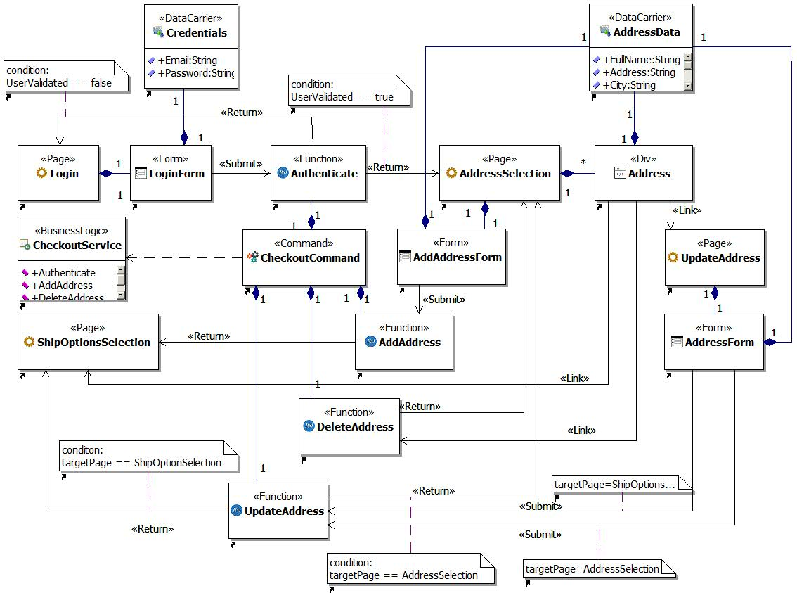
E-WAE model for authentication and address selection on Amazon

Slide 17
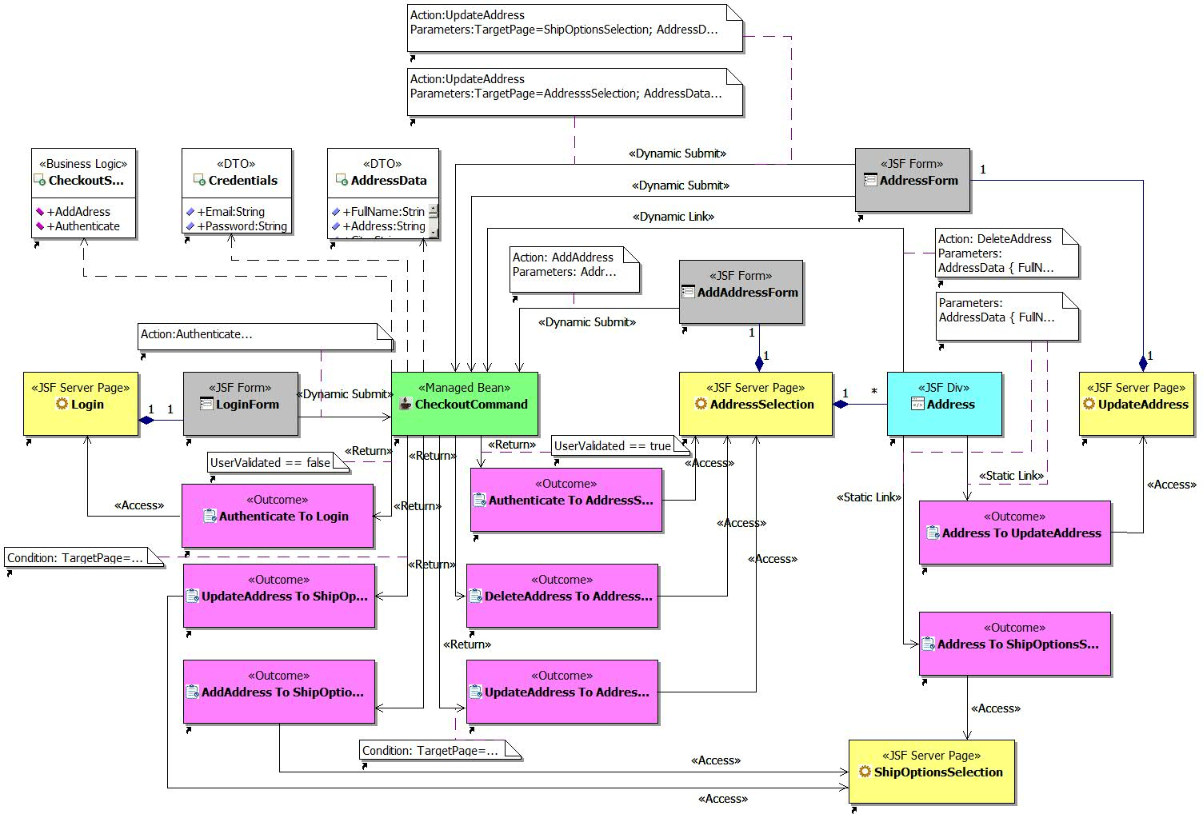
WAE4JSF model for Amazon authentication and address selection generated from E-WAE

Slide 18
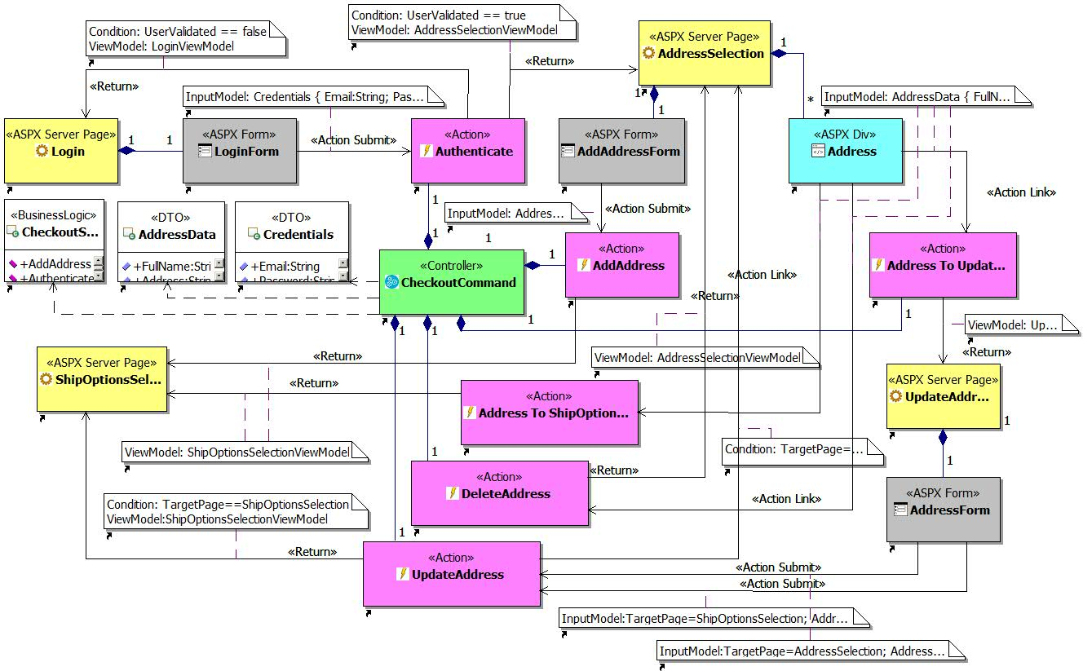
WAE4.NET model for Amazon authentication and address selection generated from E-WAE

Slide 19
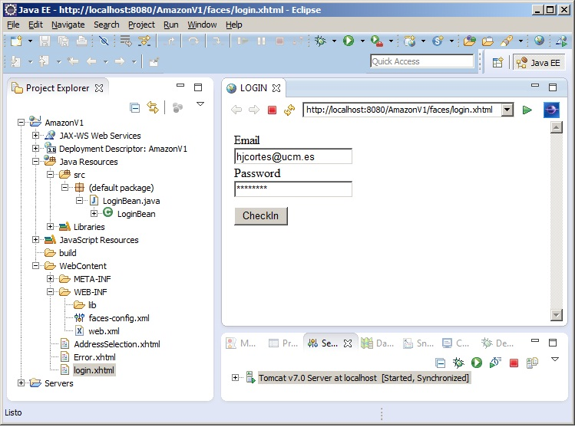
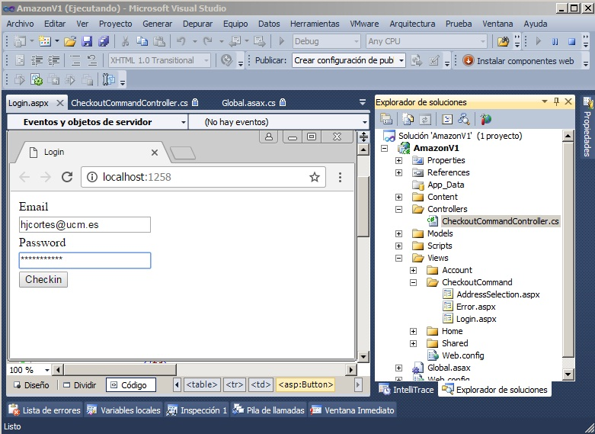
(a)
(b)
Mockups and code generated in Eclipse (a) and in MS Visual Studio (b) from WAE4x models

Slide 20
Cross-platform development tools
MDAs approaches are elegant, well defined... and quite complex.
MDA approaches are based on defining an abstract model and particularizing it into models for different platforms, which are finally translated into code.
Another lower level option is to use a language that can be executed on different platforms, and in this sense, interpreted languages are a good option for multiplatform programming.
Let's see Java.... Or not

Slide 21
Cross-platform development tools
Java is an excellent programming language, whether for enterprise, web or mobile applications:
However, we are going to see here something more focused on what is currently known as cross-platform development.
This development is particularly relevant in the development of applications for cell phones and video games.

Slide 22
Cross-platform development tools
Some cross-platform development tools are (Baldwin, 2017; Clutch 2017):
Cocos2d: 2D game development for C++, JavaScript, C#, Objective-C, Python
Corona: multiplatform 2D game development
Unity 3D: game development in UnityScript, C# or boo and export to various platforms: iOS, Android, Windows, Web, Playstation Xbox, Wii, Linux
5App: Security-based HTML5 and JavaScript development translated to Android and iOS
Adobe PhoneGap: HTML5, CSS and JavaScript translated to mobile platforms (based on Apache Cordova)
Alpha Anywhere: Development based on C#, JavaScript, Xbasic, VB.NET-supported languages (VB, Cobra, C++) and translation to mobile platforms

Slide 23
Cross-platform development tools
AngularJS (Google): HTML5, CSS and JavaScript translated to mobile platforms
Appcelerator Titanium: Reuses JavaScript code common to mov platforms.
ionic: HTML5, CSS and JavaScript translated to mobile platforms
Qt: subscription-based service for C++ translated to mov platforms.
Sencha: HTML5-based and translations to mobile platforms
Xamarin (MS): Ruby or C# code translated to mobile platforms
(Furlan, 2107), gives another view, with a short summary of programming languages

Slide 24
Cross-platform development tools
We will focus on Apache Cordova
However, I ask myself a question: how long will the market support so many platforms, so many programming languages and so many development applications?

Slide 25
Apache Cordova
The underlying idea behind Apache Cordova is quite simple:
Build a mobile application based on the use of HTML5 and CSS for the presentation layer and JavaScript for the business layer.
Apache Cordova provides generic libraries for handling mobile-specific functions (accelerometer, camera, geolocation, etc.). These libraries are called Core Plugins
HTML and CSS run in a web browser window without the address bar on mobile: the WebView (Looper, 2015).
JavaScript code that can be interpreted by a browser, is maintained
Calls to core plugins are translated into platform-specific library calls.

Slide 26
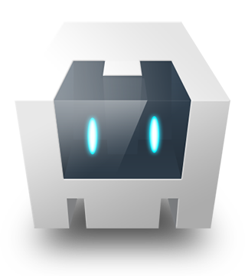
Apache Cordova
Platform-independent application
Platform-specific application (iOS)
HTML5
CSS
WebView
JavaScript
+
Calling Apache Cordova Core Plugins
JavaScript
+
Calls to iOS libraries
Apache Cordova Engine + Platform Selection (iOS)

Slide 27
Apache Cordova
In a way, it is a similar concept to MDA, but the transformations are defined between programming languages, not between design metamodels.
It is simpler, but we do not have a design model.

Slide 28
Apache Cordova
The platforms supported by Apache Cordova are:
Android
BlackBerry 10
iOS
OS X (very limited)
Ubuntu
Windows Phone 8.1
Windows 8.1, 10
Apache Cordova can work for both cross-platform and platform-specific development.

Slide 29
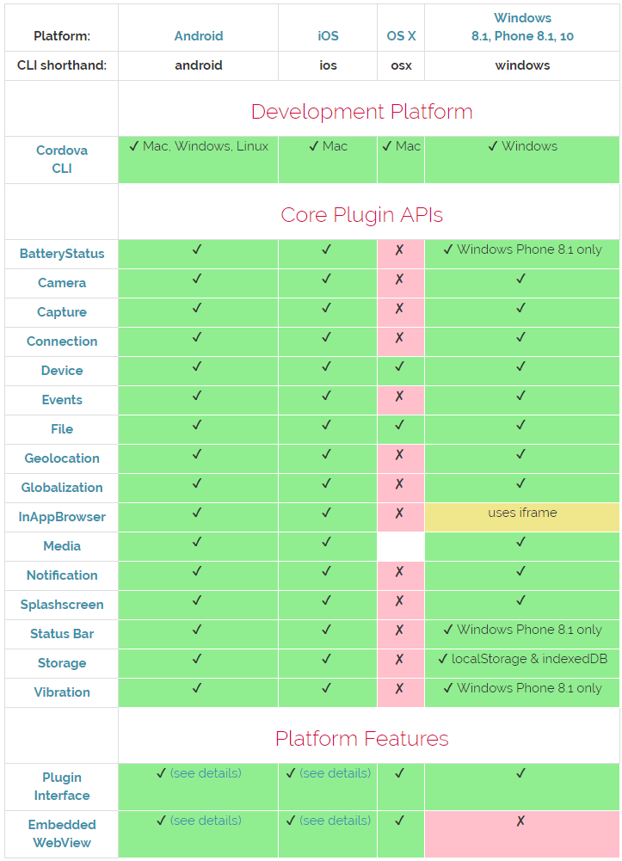
Apache Cordova platform support

Slide 30
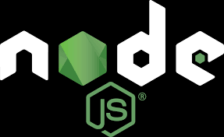
Apache Cordova
Apache Cordova runs on node.js
node.js is a server-side JavaScript interpreter that uses V8 JavaScript as its underlying engine (Abernethy, 2011).
V8 JavaScript is the engine that Google uses with its Chrome browser.
Although node.js is a server-side interpreter, it can be used locally.
It is not intended to be deployed as easily as Apache Web Server or Tomcat.

Slide 31
Apache Cordova
Building an application with Cordova is very simple: https://cordova.apache.org/docs/en/latest/guide/cli/index.html
You need to have it installed:
Android SDK
Android Studio, with an Android Virtual Device (AVD) created with no spaces in the name
An application is created from the command line: $ cordova create hello
The desired platforms are added: $ cordova platform add android
Plugins are added: $ cordova plugin add cordova-plugin-camera
HTML, CSS and JavaScript files are edited externally.
The application is built (with or without platform): $ cordova build android
The application is tested: $ cordova emulate android

Slide 32
Apache Cordova
Example:
< html> …………………………… < body> < div> <h1>Say hello</h1>. < input type="button" id="sayHello" value="greet"/> </div> <div> <h1>Photo</h1> <input type="button" id="takePhoto" value="photo" /> < div id="thePhoto"> </div> <script type="text/javascript" src="cordova.js"></script> < script type="text/javascript" src="js/index.js"></script> </body>
</html>

Slide 33
Apache Cordova
document.addEventListener("deviceready", onDeviceReady, false);
function onDeviceReady() {
document.getElementById('sayHello'). onclick = function () { alert("hello"); }
document.getElementById('takePhoto'). onclick = function () { navigator.camera.getPicture( function(imageURI){ var lastPhoto=document.getElementById("thePhoto"); lastPhoto.innerHTML="< img src='" + imageURI + "' style='width=60%;'/>" } ) } }

Slide 34
Apache Cordova
body { color:darkblue; background-color:DeepSkyBlue; }

Slide 35
Apache Cordova
Demo

Slide 36
Conclusions
The concept of platform in computer science is quite broad.
If you want to have cross-platform design and programming, the MDA/MDD (Model-Driven Develpoment) approach makes the most sense.
MDA/MDD can be very demanding, which is why simpler solutions are appearing.
Multiple platforms and tools: until when?
Apache Cordova enables cross-platform programming for mobile devices based on HTML5, CSS, JavaScript, and HTML5.

Slide 37
Multiplatform Programming
Intelligent Infrastructure Design for the Internet of Things
Antonio Navarro

